Slide 1
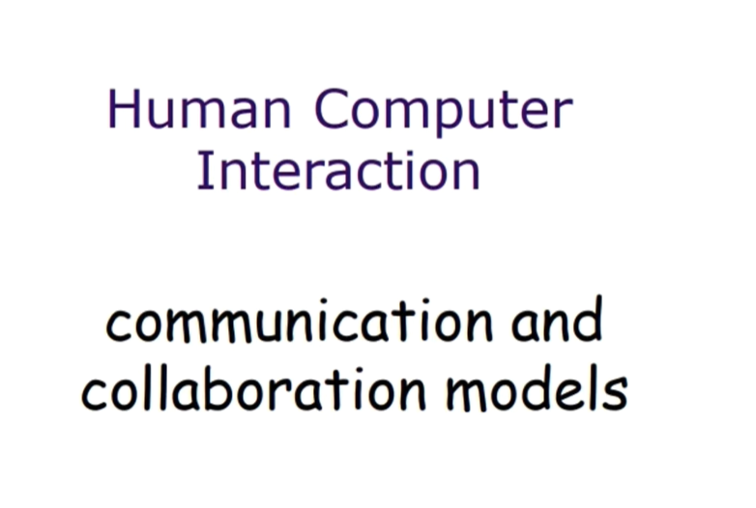

Slide 2
Communication and collaboration models and theory
All Computer Systems Have Group Impact
This applies to all systems, not just groupware.
Ignoring This Leads to System Failures
Consider Multiple Levels – From Minutiae to Large-Scale Context:
Face-to-face communication
Conversation
Text-based communication
Group collaboration

Slide 3
Communication and collaboration models and theory
All Computer Systems Have Group Impact
Computer systems influence group dynamics, whether they are explicitly designed for collaboration (e.g., groupware) or not. Even individual applications affect teamwork, workflow, and communication.
Why Ignoring This Leads to System Failures
Failure to consider group interactions can result in:
Poor user adoption due to ineffective collaboration features.
Miscommunication among users, reducing efficiency.
Workflow bottlenecks caused by rigid or non-intutive

Slide 4
Communication and collaboration models and theory
All Computer Systems Affect Groups
The statement asserts that computer systems always have an influence on group interactions, whether or not they are intentionally designed for collaboration.
Explicitly Collaborative Systems (Groupware)
Some systems are specifically designed to facilitate teamwork, such as groupware (e.g., Microsoft Teams, Slack, Google Docs). These tools directly shape communication, coordination, and productivity.
Individual Applications Also Influence Group Dynamics
Even software meant for solo use can affect teamwork. For example:
A word processor (like Microsoft Word) can impact how documents are shared and edited within a team.
A project management tool (like Trello or Asana) structures workflow and delegation.
Even personal productivity software (like note-taking apps) can influence group efficiency if individuals bring insights from them into discussions.

Slide 5
Why Ignoring Group Dynamics Leads to System Failures
When system designers fail to account for group interactions, the following issues can arise:
Poor User Adoption Due to Ineffective Collaboration Features
If a system lacks features that support teamwork (e.g., real-time editing, version control, or easy file sharing), users may avoid or resist using it.
Example: A project management tool without notifications or task delegation options will struggle to be useful in a team setting.
Miscommunication Among Users, Reducing Efficiency
If a system does not facilitate clear and effective communication, misunderstandings can occur, leading to mistakes and delays.
Example: A healthcare system that doesn’t allow nurses and doctors to leave real-time updates may cause critical patient information to be missed.

Slide 6
Why Ignoring Group Dynamics Leads to System Failures
Workflow Bottlenecks Due to Rigid or Non-Intuitive Design
If the system enforces a rigid workflow that doesn’t match the real needs of users, teams may struggle to complete tasks efficiently.
Example: A customer service ticketing system that requires unnecessary approvals may slow down response times.

Slide 7
Communication and collaboration models and theory
Need to Understand Normal Human Communication – Why?
Face-to-Face Communication
Involves eyes, face, and body gestures.
Most fundamental and subtle form of communication.
Influenced by the physical environment.
Conversation
Conversations can be analyzed to establish their detailed structure.
Spoken or written exchanges, structured or unstructured.
Digital tools like VoIP, chat applications, and collaborative forums support this.
Poorly designed systems may hinder discussion flow or misinterpret user intent.

Slide 8
Communication and collaboration models and theory
Text-Based Communication
The same principles can be applied to text-based conversation.
Slower pace of interaction.
Less context to clarify expressions.
Reduced feedback in conversations.
Easier to review and reference later.

Slide 9
Communication and collaboration models and theory
Group Collaboration
Encompasses task management, shared workspaces, and decision-making tools.
Examples include project management software (Trello, Asana), version control (Git), and cloud collaboration (Google Docs, Microsoft Teams).
Key challenges include version conflicts, access control, and integration with other tools.

Slide 10
Communication and collaboration models and theory
Group Working
More complex than individual work:
Coordination among multiple people introduces challenges such as communication gaps, task dependencies, and differing work styles.
Experiments are harder to control and record:
Unlike single-person studies, group interactions involve unpredictable variables, making it challenging to ensure consistency and repeatability.
Field studies must consider the social situation:
Factors like hierarchy, cultural norms, and team dynamics influence how people collaborate.
Seen as a paradigm for computer-mediated communication:
Many collaborative tools (e.g., Slack, Microsoft Teams, Zoom) are designed to facilitate group work, reflecting the shift from face-to-face to digital communication.

Slide 11
Social Nature of Humans
This slide explains the inherently social nature of humans and the need for interaction and communication.
Humans as Social Beings
Humans are naturally social creatures, often referred to as social animals.
Living and Working Together
People live, work, eat, and play in groups.
They cannot function alone effectively.
The mention of punishments suggests that isolation may be used as a form of social control.
Need for Interactive Systems
Since humans rely on social interactions, they must develop systems that facilitate and extend these interactions.
Examples include communication and collaboration tools.

Slide 12
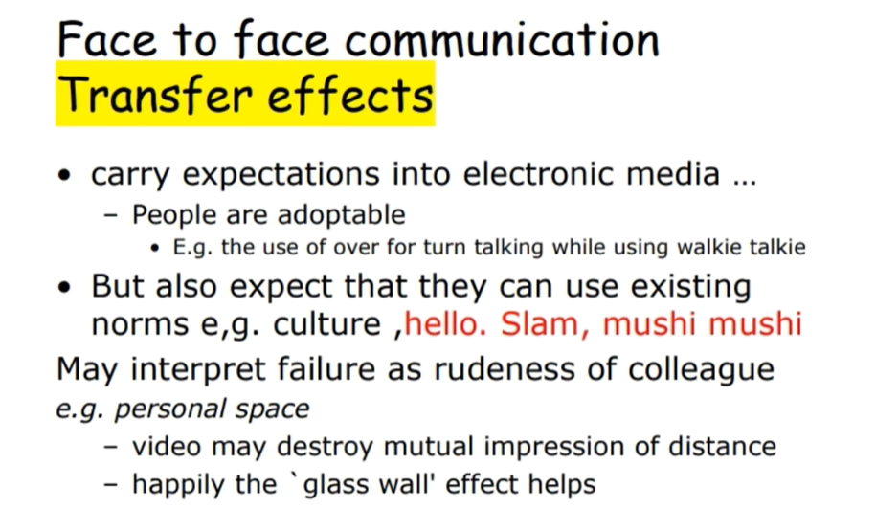

Slide 13
Communication and collaboration models and theory
Face-to-Face Communication: Transfer Effects
The slide explores how communication habits and expectations from face-to-face interactions influence electronic communication.
1. Carrying Expectations into Electronic Media
People naturally bring their communication habits into digital spaces.
They are adaptable, meaning they adjust their behavior to suit new communication methods.
Example: In walkie-talkie communication, people use "over" to indicate turn-taking, adapting to the medium's constraints.

Slide 14
Communication and collaboration models and theory
2. Expecting Existing Norms to Apply
People assume that familiar cultural communication norms still apply in digital interactions.
This includes the way they greet and interact with others.
Examples of cultural greetings:
"Hello" (English)
"Slam" (short for "As-salamu alaykum" in Arabic)
"Mushi mushi" (Japanese phone greeting)
3. Misinterpretation Leading to Perceived Rudeness
When familiar communication norms fail in electronic media, people may misinterpret this as rudeness.
A colleague’s delayed response, lack of customary greetings, or abrupt messages may be seen as impolite rather than a limitation of the medium.

Slide 15
Communication and collaboration models and theory
4. Personal Space & Video Communication
In face-to-face communication, personal space is crucial.
Video communication can disrupt this sense of distance, making interactions feel unnatural or intrusive.
However, the "glass wall" effect (the screen acting as a psychological barrier) helps maintain some level of comfort.
This slide highlights how our real-world communication habits influence and sometimes conflict with electronic media, leading to both adaptation and misunderstandings.

Slide 16
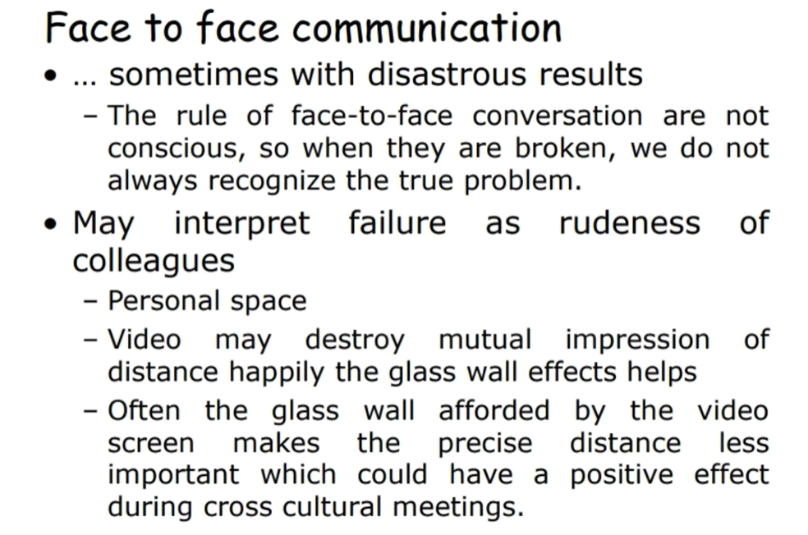

Slide 17
Eye Contact in Communication
To Convey Interest and Establish Social Presence
Eye contact is a crucial nonverbal communication tool.
It helps demonstrate engagement, attentiveness, and sincerity in conversations.
In face-to-face interactions, maintaining appropriate eye contact can build trust and rapport.
Video May Spoil Direct Eye Contact
In video calls, eye contact is often disrupted because people look at the screen instead of the camera.
This can make it seem like a person is not fully engaged or avoiding eye contact.
Some platforms use AI-driven tools to correct gaze direction, but it may still feel unnatural.

Slide 18
Eye Contact in Communication
Poor Quality Video is Better Than Audio-Only
Even if video quality is low, having a visual element is better than relying solely on audio.
Seeing facial expressions, gestures, and body language adds important context to communication.
It helps create a sense of presence and connection, making interactions more personal.
"Thankyou" vs "Thank you"
"Thank you" (two words) is the correct form in formal writing and standard English.
"Thankyou" (one word) is often used informally but is generally considered incorrect in formal contexts.
The distinction may be highlighted to emphasize the importance of correct language use in communication.

Slide 19
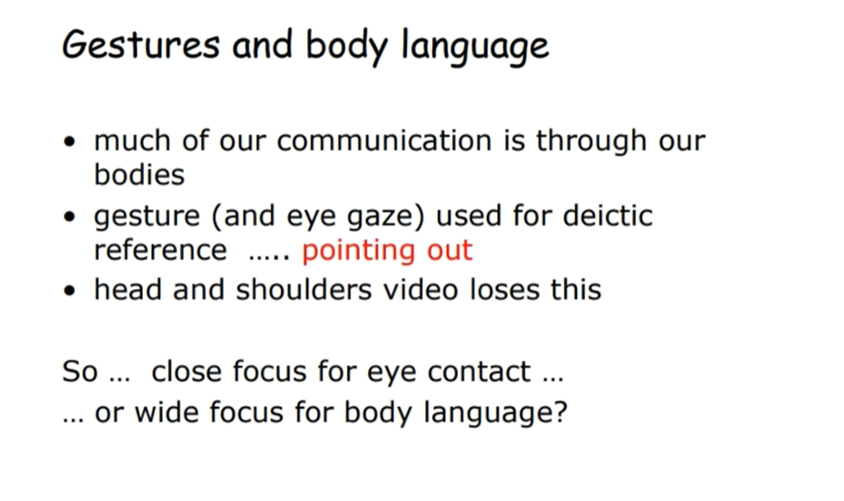

Slide 20
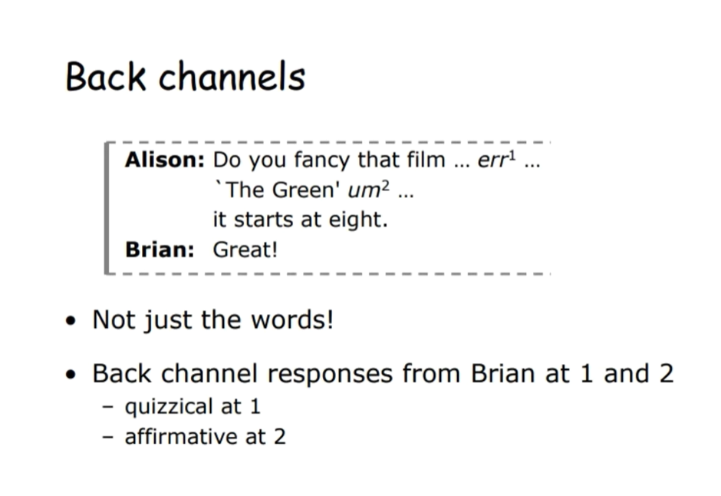

Slide 21
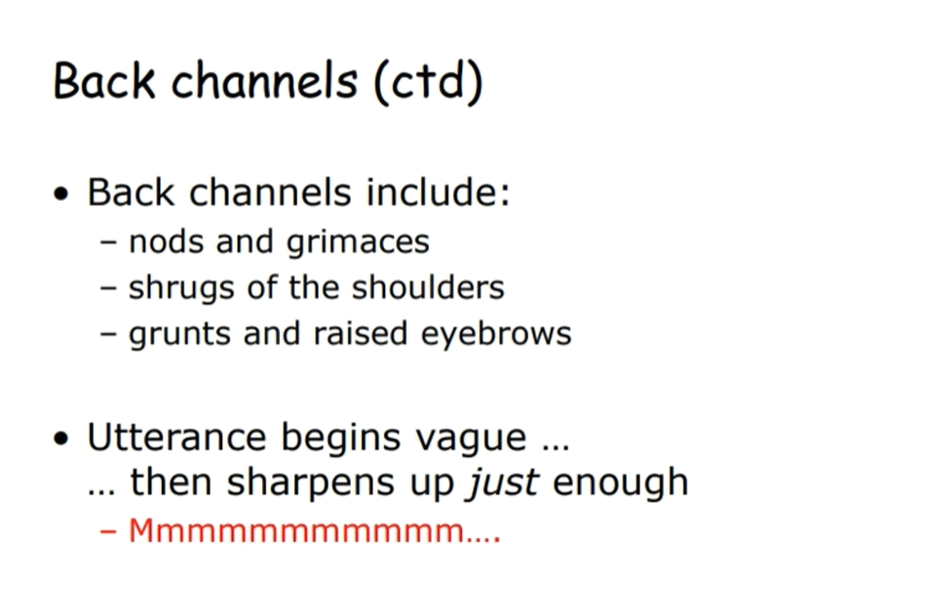

Slide 22
Back Channels - Media Effects
Restricting media restricts back channels
Video → Loss of body language
Audio → Loss of facial expression
Half duplex → Lose most voice back-channel responses (e.g., walkie-talkie)
Text-based → Nothing left!

Slide 23
Back Channels - Media Effects
Back Channels in Communication
Back channels are nonverbal or verbal cues (e.g., nodding, "mm-hmm," facial expressions) that show engagement in a conversation.
Restricting communication media limits these cues, making interactions feel less natural.
Media Limitations on Back Channels
Video: While it provides visual interaction, it limits subtle physical cues like posture or gestures.
Audio: Removes visual back channels, making it harder to interpret emotions or engagement.
Half Duplex (e.g., Walkie-Talkie): Only one person speaks at a time, eliminating natural interruptions and real-time feedback.
Text-Based (e.g., SMS, chat): Completely removes nonverbal communication, making tone and intent harder to interpret.

Slide 24
Back Channels - Media Effects
"Later vs SMS"
Possibly refers to the difference between a delayed response (later) versus an instant message (SMS).
SMS/text lacks real-time engagement, making back-channel feedback impossible.

Slide 25
Back Channels and Turn-Taking
In a meeting:
Speaker offers the floor (fraction of a second gap)
Listener requests the floor (facial expression, small noise)
Grunts, ‘um’s and ‘ah’s can be used by:
Listener to claim the floor
Speaker to hold the floor
… but often too quiet for half-duplex channels
Example: Trans-continental conferences – special problem
Lag can exceed the turn-taking gap
… leads to a monologue!

Slide 26
Back Channels and Turn-Taking
Turn-Taking in Conversations
In spoken communication, people naturally take turns speaking.
A speaker offers the floor by pausing slightly.
A listener requests the floor through subtle cues like facial expressions, small noises ("mm-hmm"), or slight movements.
Role of Back-Channel Noises ("um", "ah")
Listeners use these sounds to signal they want to speak.
Speakers use them to indicate they are still thinking and wish to continue speaking.
However, these cues can be too quiet for certain communication technologies (e.g., half-duplex systems like walkie-talkies), leading to disrupted turn-taking.
Challenges in Remote Communication (e.g., International Video Calls)
Lag in transmission can cause delays, making natural turn-taking difficult.
If a gap is too long, a speaker may assume no one else wants to talk and continue speaking, leading to an unintentional monologue.

Slide 27
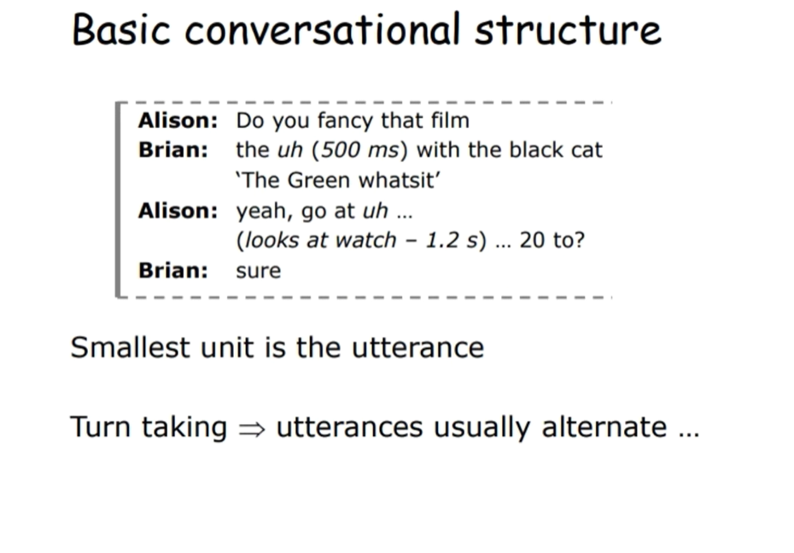

Slide 28
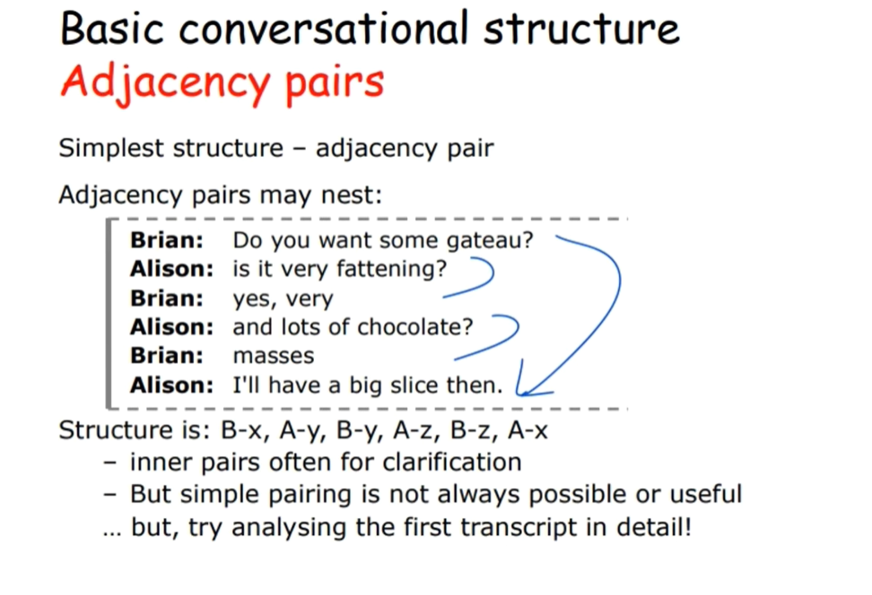

Slide 29
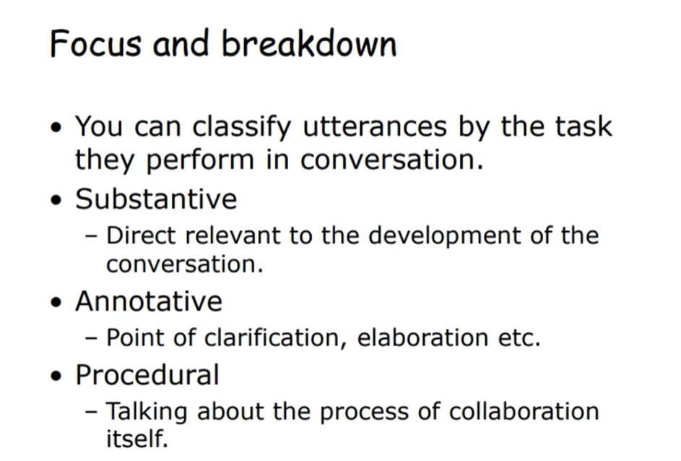

Slide 30
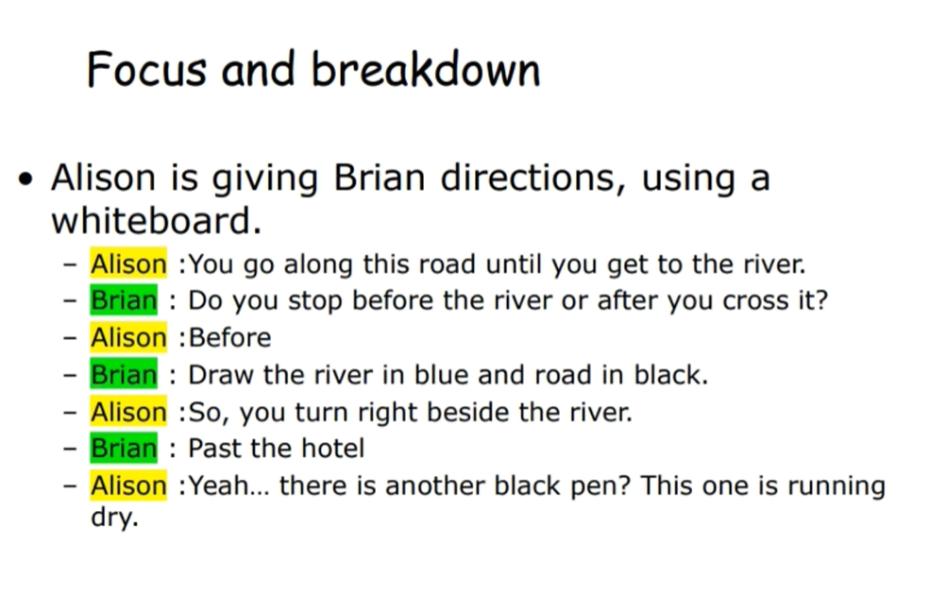

Slide 31
